Slide 1
Intro to Functional Anatomy
Ch. 1 Lippert
p. 3-10

Slide 2
Terminology
Kinesiology
Study of movement
Brings together anatomy, physiology, physics, and geometry and relates them to human movement
Utilizes principles of mechanics, musculoskeletal anatomy and neuromuscular physiology
Biomechanics
Mechanical principles that relate directly to the human body
Static (non-moving)
Dynamic (moving)
Kinetics
Kinematics

Slide 3
Dynamic Systems (Moving)
Kinetics
Forces causing movement
Kinematics
Time, space, and mass aspects of a moving system
**will discuss more later in Ch. 8**

Slide 4
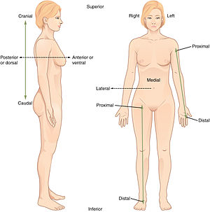
Descriptive Terminology
Anatomical Position
Standing in an upright position, eyes facing forward, feet parallel and close together, arms at the sides of the body with the palms facing forward

Slide 5
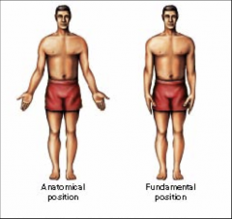
Fundamental Position
Same as anatomical
Except palms face the sides of the body

Slide 6
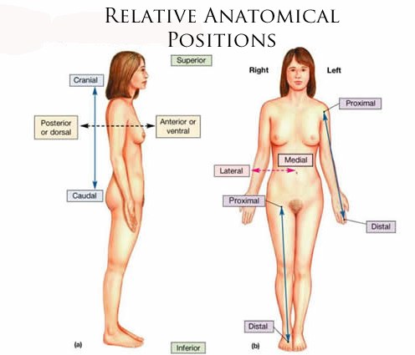
Descriptive Terminology
Medial/Lateral
Anterior/Posterior
Ventral/Dorsal
Distal/Proximal
Superior/Inferior
Cranial/Caudal
Superficial/Deep
Supine/Prone
Bilateral/Contralateral/Ipsilateral
Notes:
Medial – close to midline
Lateral – farther from midline
Anterior or ventral – front of body
Posterior or dorsal – back of body
Distal – away from the trunk
Proximal – toward the trunk
Superior – location of body part above another structure
Inferior – location of body part below another structure
Cranial – position close to the head
Caudal – position closer to the feet
Superficial – relative depth to another structure – closer to the skin
Deep – relative depth to another structure – further from skin
Supine – lying face up
Prone – lying face down
Bilateral – tow or both sides
Contralateral – opposite side
Ipsilateral – same side

Slide 7
Segments of the Body
Upper Extremity
Arm
Forearm
Hand
Lower Extremity
Thigh
Leg
Food
Trunk
Thorax
Abdomen
Neck
Head
Notes:
Arm = b/w shoulder and elbow
Forearm = b/w elbow and wrist
Hand = distal to wrist
Thigh = b/w hip and knee
Leg = b/w knee and ankle
Foot = distal to ankle
Thorax = chest; made up of ribs, sternum, and thoracic vertebrae
Abdomen = lower trunk; pelvis, stomach, and lumbar vertebrae
Neck = cervical vertebrae
Head = skull

Slide 8
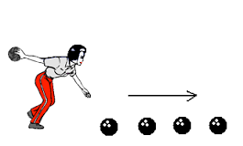
Types of Motions
Linear Motion
Translatory motion
More or less a straight line from one location to another

Slide 9
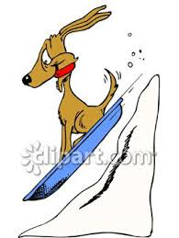
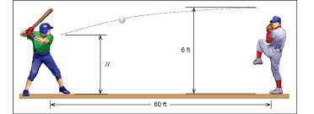
Linear Motions
Rectilinear motion
Object moves along a straight line
Curvilinear motion
Movement occurs in a curved path that isn’t necessarily circular
Notes:
Rectilinear: child sledding down a hill; sailboarder moving across the water; baseball player running from home plate to 1st base
Curvilinear: path a diver takes after leaving the diving board; path of a thrown ball

Slide 10
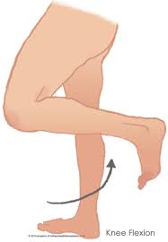
Angular Motions
Movement of an object around a fixed point
Rotary motions
All the parts of the object move through the same angle, in the same direction, and at the same time
They do not move the same distance
Notes:
When a patient flexes his or her knee, the foot travels farther through space than does the ankle or leg

Slide 11
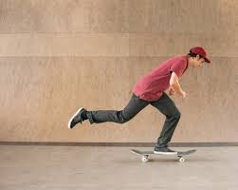
Combined Motions
Use both throughout the day
Entire objects moving in linear fashion
Individual parts moving in angular fashion
I.E.
Skateboarder
Walking
Throwing a ball
Movement within the body: Angular
Movement outside the body: Linear
Notes:
Skateboarder whole body moves down the street (linear) while individual joints on the ‘pushing’ leg (hip, knee, ankle) rotate about their axes (angular motion)
Walking: Whole body exhibits linear motion walking from point A to B; hips, knees, and ankles exhibit angular motion
Throwing a ball: Upper extremity joints in an angular direction – ball travels in curvilinear path
Scapula moving into retraction/protraction/elevation/depression is linear
Clavicle moving is angular – sternoclavicular joint

Slide 12
Joint Movements
Osteokinematics
Movement of bones around a joint axis
Humerus moving on scapula
Arthrokinematics
Joint surface movement
Humeral head moving on glenoid fossa

Slide 13
Flexion
Bending movement of one bone on another
Decrease in joint angle
Extension
Straightening movement of one bone away from another
Increase in joint angle
Hyperextension
Continuation of extension beyond anatomical position

Slide 14
Palmar Flexion
Flexion at wrist
Plantar Flexion
Flexion at ankle
Dorsiflexion
Extension at wrist and ankle joints
Abduction
Movement away from the body/midline
Abd = A Boy Dog
Adduction
Movement toward the body/midline

Slide 15
Horizontal abduction
Preceded by flexion or abduction of shoulder
Shoulder movement backwards
Horizontal adduction
Shoulder movement forwards
Radial Deviation
Hand moves laterally
Toward thumb side
Ulnar Deviation
Hand moves medially
Toward pinkie side

Slide 16
Lateral bending
Trunk moves sideways
Neck moves sideways
Circumduction
Circular, cone-shaped pattern
4 joint motions
Flexion, Abduction, Extension, Adduction

Slide 17
Rotation
Medial (internal)
Anterior surfaces rolls inward toward midline
Lateral (external)
Anterior surfaces rolls outward away from midline
Supination
Palm facing forward
Turning palms upward
Pronation
Palm facing backward
Turning palms down

Slide 18
Motions specific to certain joints
Inversion
Sole of foot inward at the ankle
Eversion
Sole of foot outward at the ankle
Protraction
Linear movement along a plane parallel to the ground and away from midline
Retraction
Linear movement along a plane parallel to the ground and toward midline

