Slide 1
Arthrokinematics

Slide 2
Joint Motion
Osteokinematic: Bone moving on another bone; joint motion; path of moving bone
Arthrokinematic: motion that occurs between the articular surfaces of joints; joint surface motion

Slide 3
Osteokinematic Motion
AROM: muscles move joint through ROM
PROM: joint is passively moved through ROM
Why perform?
To determine available ROM
Assess end feel
Quality of the feel when slight pressure is applied at the end of the joint’s PROM

Slide 4
End Feels
Abnormal
Bony
fracture
Muscle spasm
Reflex guarding
Empty
Pain limits
Springy block
Meniscus tear
Normal
Bony (hard)
Elbow extension
Soft tissue stretch (firm)
Hip ER
Soft tissue approximation(soft)
Elbow flex

Slide 5
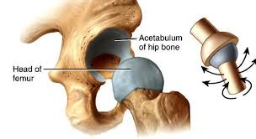
Arthrokinematic Motion
Joint surface shape determines type of motion occurring at a joint
Joint surfaces are curved
Concave
Convex
Arthrokinematics must occur for normal ROM
Accompany AROM but not under voluntary control

Slide 6
Types of Arthrokinematic Motion
Roll (A)
Rolling of 1 joint surface on another
New points on each surface make contact throughout ROM
Multiple points along one rotating articular surface contact multiple points on another articular surface
Tire rotating across a stretch of pavement

Slide 7
Types of Arthrokinematic Motion
Slide or glide (B)
Single point on one articular surface contacts multiple points on another articular surface
Linear movement of a joint surface parallel to the plane of the adjoining joint surface
1 point on a joint surface contacts new points on the adjacent surface
Stationary tire skidding across a stretch of icy pavement
Ice skater’s blade

Slide 8
Types of Arthrokinematic Motion
Spin(C)
Rotation of the movable joint surface on the fixed adjacent surface
Same point on each surface remains in contact with each other
Spin occurs along a central longitudinal axis regardless of convex/concave
Top spinning on table
Humerus rotating in glenoid fossa (IR/ER)
Prox RUJ supination/pronation
* Most joint motion = a combination of all 3

Slide 9
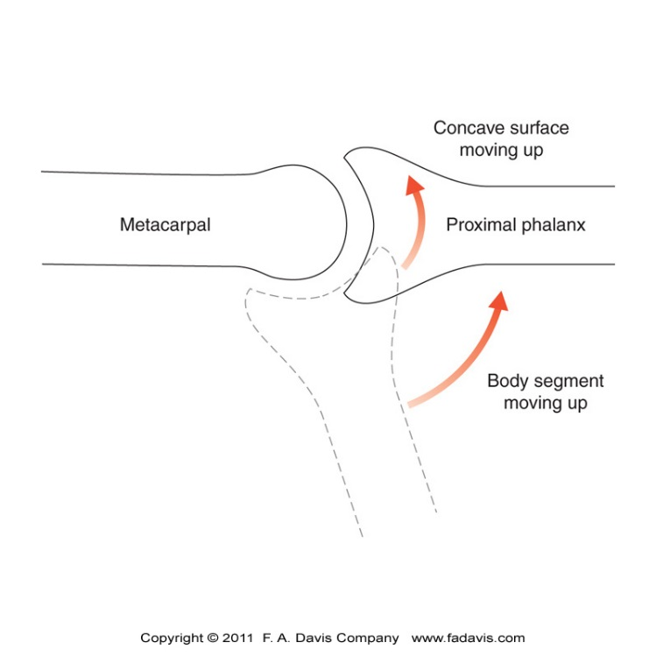
Convex-Concave Rule
Concave on convex
Concave joint surface moves in the same direction as the body segment’s motion
Convex on concave joint surface
Convex joint surface moves in the opposite direction of the body segment’s movement

Slide 10
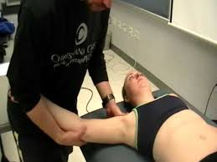
Arthrokinematics and Physical Therapy
Normally arthrokinematic motions occur naturally and are integral to proper ROM
However, normal arthrokinematics may become dysfunctional
Ex decreased shoulder joint inferior glide with “shoulder impingement syndrome”
Physical Therapy
Assessment= Joint Play
Treatment = Joint Mobilization

Slide 11
Joint Surface Positions
When a joint is congruent, the joint surfaces
Have maximum contact with each other
Are tightly compressed
Are difficult to distract
Ligaments and capsule are taut
Are in the CLOSED PACKED position
Position of testing for stability
Often in this position when injured

Slide 12
Joint Surface Positions
In all other positions, the joint surfaces are incongruent
Open-packed or loose-packed position or resting position
Capsule and ligaments lax
Minimal congruency between the articular surfaces
Joint mobilization techniques are started in this position

Slide 13
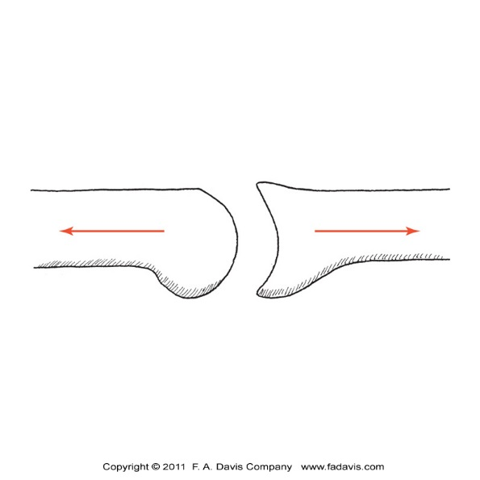
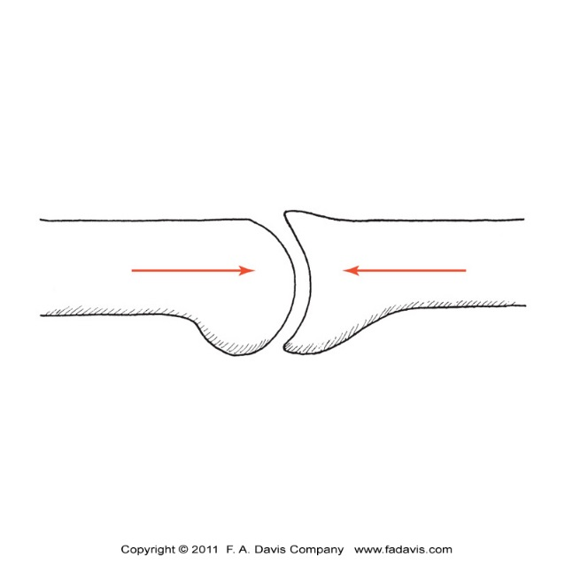
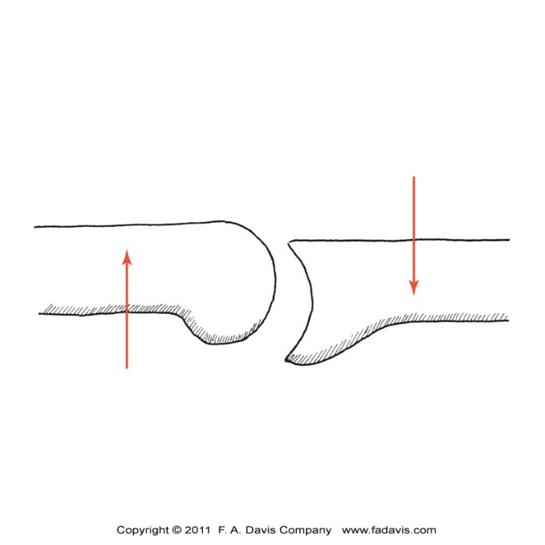
Accessory Motion Forces
Traction
Approximation
Shear

