Slide 1
Articular System

Slide 2
Purposes of Joints
Allow motion
Bear weight
Provide stability

Slide 3
Types of Joints
1. Fibrous: thin layer of fibrous periosteum between 2 bones
2. Cartilaginous or amphiarthrosis: has either hyaline or fibrocartilage between the 2 bones
3. Synovial: no direct union with bones, cavity with synovial fluid

Slide 4
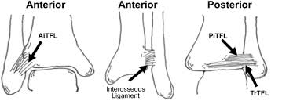
Classification of Fibrous Joints
Synarthrosis
Suture joint
Junction between bones allowing little to no movement
Firmly binds bones together and transmit forces from one bone to another
Syndesmosis
Ligamentous joint
Little to no movement

Slide 5
Amphiarthrosis or Cartilaginous Joints
Formed primarily by fibrocartilage or hyaline cartilage
Allows limited amount of motion
Primary function is to provide shock absorption

Slide 6
Synovial Joints
2 bones
“ diarthosis”
Articular cartilage
Joint capsule
Synovial membrane
Synovial Fluid
Ligaments

Slide 7
Synovial Joint Classification
1. Plane joint
Articulation between two relatively flat bony surfaces
Allows limited amount of motion; may slide and rotate in many different directions
nonaxial
ex intercarpal joints of the hand

Slide 8
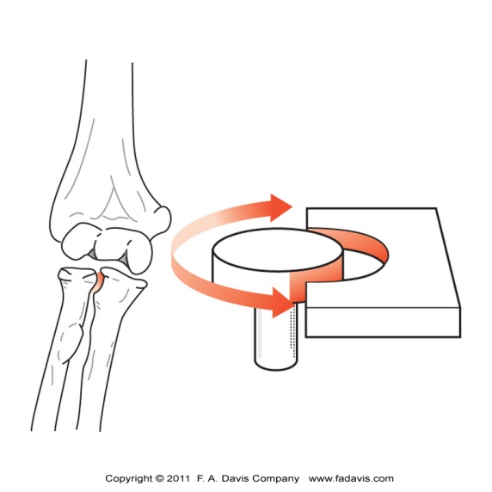
Synovial Joint Classification
2. Hinge joint
Allows motion in only one plane about a single axis of rotation, similar to the hinge of a door
uniaxial
ex humeroulnar joint (elbow)
3. Pivot joint
Allows rotation about a single longitudinal axis of rotation, similar to the rotation of a doorknob
uniaxial
ex proximal radioulnar joint

Slide 9
Synovial Joint Classification
4. Saddle joint
One concave and one convex surface
Allows extensive motion, primarily in two planes
biaxial
ex carpometacarpal joint of the thumb

Slide 10
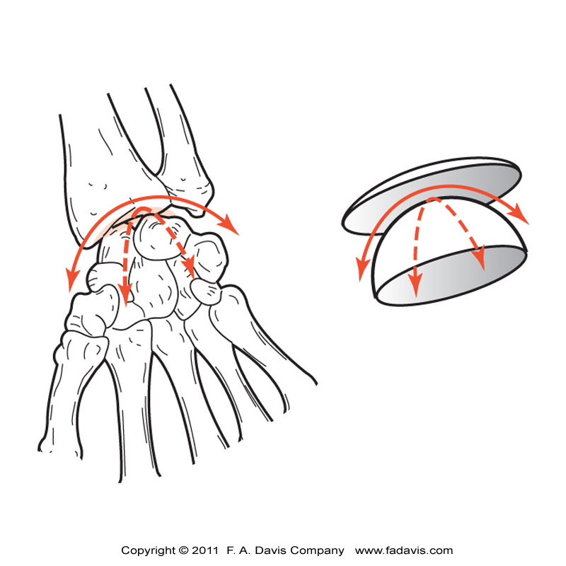
Synovial Joint Classification
5. Condyloid joint
Convex elongated surface articulates with a concave surface
Allows motion to occur in two planes
biaxial
ex radiocarpal (wrist) joint

Slide 11
Synovial Joint Classifications
6. Ball-and-socket joint
Articulation between spherical convex surface and cup-like socket
Allows wide ranges of motion in all three planes
multiaxial
ex hip joint

Slide 12
Connective Tissue
All connective tissues supporting the joints of the body are composed of
fibers
ground substance
cells
Blended in various proportions depending on the joint’s mechanical demands

Slide 13
Connective Tissue Fibers
Collagen
Type 1
Thick and rugged, designed to resist elongation
“dense irregular connective tissue”
Ligaments, tendons, joint capsule
Type 2
Thinner and less stiff than type 1
Flexible, woven framework to maintain shape
Articular cartilage
Elastin
Elastic in nature
Resist stretching (tensile forces)
Have more give when elongated
Allow tissue to bend a great deal before breaking

Slide 14
Stress-Strain Curve

Slide 15
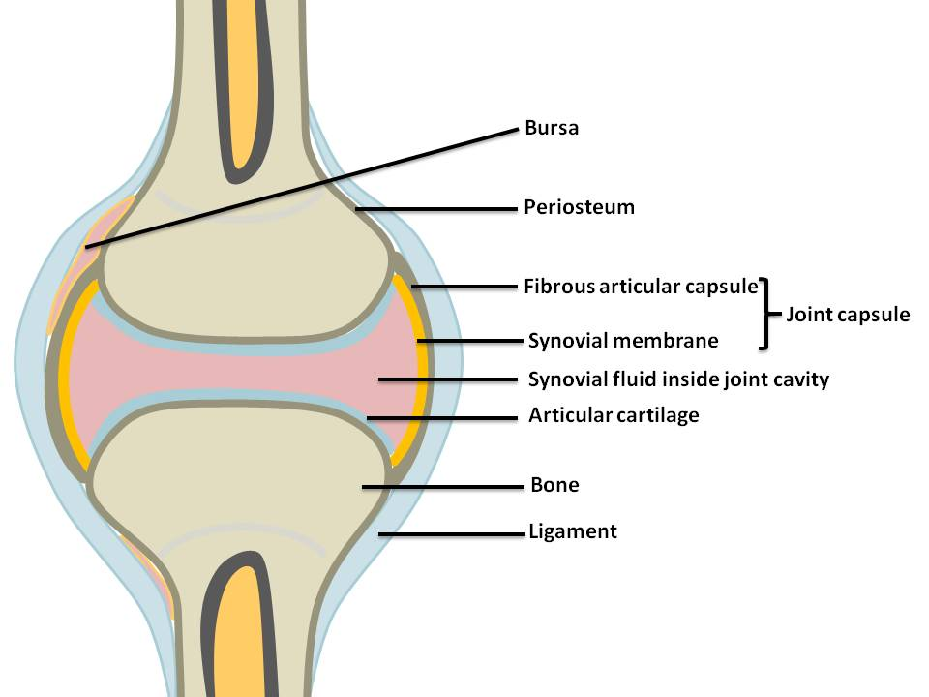
Joint Structure
2 bones
Articular cartilage
Dissipates and absorbs compressive forces
Joint capsule
Connective tissue that surrounds and binds joints together
Synovial membrane
Produces synovial fluid
Synovial Fluid
Joint lubrication and nutrition
Ligaments

Slide 16
Ligaments
Thickened regions of connective tissue that connect bone to bone
Limit excessive joint motion
Increase stability of joint

Slide 17
Cartilage
Dense fibrous connective tissue that can withstand compressive and shear forces through articular surfaces
Reduces friction between joint surfaces
Articular cartilage = HYALINE cartilage : covers ends of bones in synovial joints, provides smooth articulating surfaces
Type II collagen
Lacks blood supply (avascular)
Receives its nourishment from synovial fluid
“milking” action when cartilage deformed during joint loading
Can’t repair self if damaged
Aneural

Slide 18
Cartilage
Fibrocartilage
Shock absorption
Resists and disperses compressive and shear forces
Support and stabilization to joints
Important in weight-bearing joints
Healing: some tissue repair when near vascularized structures
Ie poor healing = innermost meniscus
Examples: intervertebral disc, between clavicle and sternum, triangular fibrocartilage, labrum

Slide 19
Labrum
Fibrocartilage
Deepens the joint
Example: shoulder labrum deepens the glenoid fossa
Increases stability

Slide 20
Capsule
Characteristic of synovial joints
Surrounds the joint
Connective tissue blends with ligaments
Protects articular surfaces
Provides stability
2 layers
Synovial membrane
Secretes synovial fluid

Slide 21
Synovial Fluid
Lubricates articular cartilage
Reduces friction during movement
Nutrition for articular cartilage
“egg-white” consistency
Found in joints, bursa and tendon sheaths

Slide 22
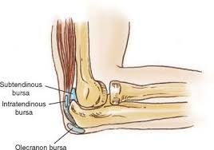
Bursa
Fluid filled sacs
Decreased friction between tendon and bone

Slide 23
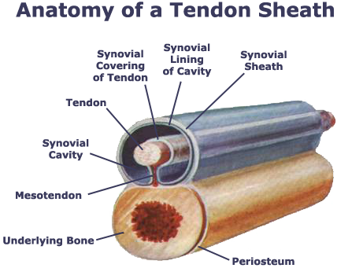
Tendon
Tendons: connect muscle to bone and convert muscular force into bony motion
Tendon sheaths: “fibrous sleeves” around the tendon, decreases friction when passes between muscles or bones, lubricated with fluid

Slide 24
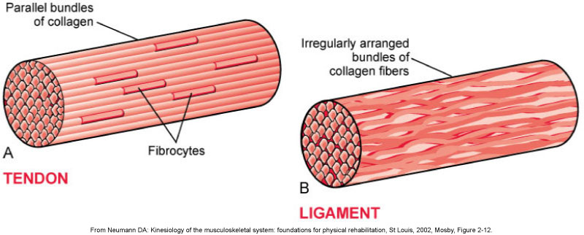
Tendon vs Ligament
Ligaments: connect bone to bone
Function primarily to maintain joint stability
Collagen fibers aligned irregularly
Allows ligament to accept tensile forces from different directions while maintaining stability of joint
Tendons: connect muscle to bone
Convert muscle force to active range of motion (AROM) mobility
Collagen fibers aligned parallel
Allows minimal loss of energy as muscle force transmitted to joint motion

Slide 25
Immobilization and Connective Tissues
Immobilization may be necessary after injury to facilitate healing but can adversely affect joint
Increases stiffness and decreases tissue ability to withstand forces

Slide 26
Immobilization
Histology and normal mechanics of tissue changed with immobilization
Tissue dehydration
Increase stiffness of the joint’s connective tissue
Fibrosis and adhesions
Decreased ROM
Tissue weakness
Decrease tensile forces on structures contribute to decline in strength of tissues
Immobilization alters the strength of soft tissues within days
Decreased ability of tissues to withstand forces
Ligaments and tendons lose 50% of their tensile strength after immobilization for 8 weeks

Slide 27
Issues with Joints
Dislocation
Subluxation

Slide 28
“Itis”
Tendonitis
Bursitis

Slide 29
Sprain vs Strain
Sprain
Strain

