Slide 1
Chapter 2 Skeletal System

Slide 2
Functions of the Skeleton
Rigid framework of the human body
Gives support and shape to body
Protects vital organs
Brain, spinal cord, heart
Assists in movement
Manufactures blood cells
Stores calcium and other mineral salts

Slide 3
Types of Skeletons
206 bones in the body (table 2-1)
Axial- forms the upright part of the body
Approximately 80 bones
Head, thorax and trunk
Appendicular- attaches to the axial skeleton
Contains 126 bones
Extremities

Slide 4
Pink: Axial Skeleton
Yellow: Appendicular Skeleton

Slide 5
Composition of Bone
Bones are considered organs and made up of several types of tissue
Fibrous, cartilaginous, osseous, nervous, vascular
Integral parts of the skeletal system
Made up of:
1/3 organic (living) materials- give bone elasticity
2/3 inorganic (nonliving) materials- provides hardness and strength

Slide 6
Composition of Bone
Compact (cortical) bone
Makes up hard, dense, outer shell
Completely covers bone
Tends to be thicker along the shaft and thinner at the ends of long bones
Absorbs compressive forces
Is thicker in the plates of the flat bones of the skull
Cancellous bone
Is porous, spongy and lightweight
Inside portion called the trabeculae, which is filled with marrow and make bone lighter
Arranged in a pattern that resists local stresses and strains
Redirects forces toward weight bearing sources
Makes up most of the articular ends of bones

Slide 7
Structure of Bone
Diaphysis
The main, central shaft of the bone
Made of mostly compact bone which gives strength
Epiphysis
The area at each end of a long bone
Wider than the shaft
Primarily composed of spongy bone
Transmits weight-bearing forces across body
Epiphyseal plate- cartilaginous material in growing bone

Slide 8
Structure of Bone
Articular cartilage
Lines articular surface of each epiphysis
Acts as a shock absorber between joints
Periosteum
Thin fibrous membrane covering long bone
Contains nerve and blood vessels
Attachment point for tendons and ligaments

Slide 9
Structure of Bone
Medullary cavity
Hollow tube-like center within long bone diaphysis
Decreases weight of bone
Store bone marrow and provides passage for arteries
Endosteum
Membrane that lines the medullary cavity
Houses cells important for forming and repairing bones
Metaphysis
The flared part at each end of the diaphysis
Made of mostly cancellous bone; supports epiphysis

Slide 11
Types of Bones
Long
Short
Flat
Irregular

Slide 12
Long Bones
Contains an obvious axis or shaft
Expanded bone portion at each shaft end
Examples: femur, humerus, radius

Slide 13
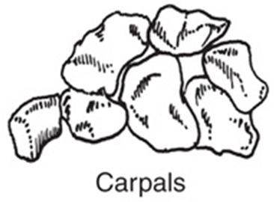
Short Bones
Tend to have more equal dimensions of height, length, and width, giving them a cube shape
Great deal of articular surface
Usually articulate with more than one bone
Examples: wrist (carpals) and ankle (tarsals)

Slide 14
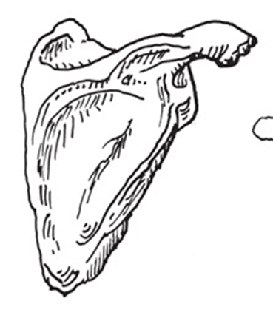
Flat Bones
Very broad surface but are not very thick
Curved surface rather than flat
Ex: scapula and sternum

Slide 15
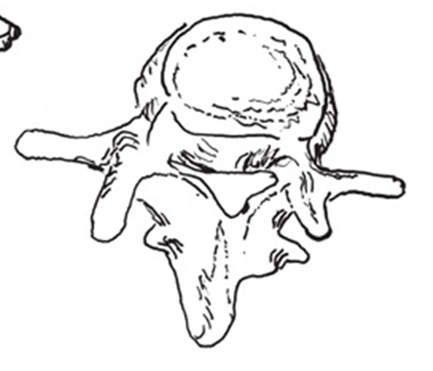
Irregular Bones
Variety of mixed shapes
Sesamoid bone
Encased within muscle tendons
Protect the tendon and increase the muscle’s leverage

Slide 16
Bone Markings: Depressions and Openings
Foramen- hole through which blood vessels, nerves, and ligaments pass (Ex: vertebral foramen of cervical vertebrae)
Fossa- hollow or depression (Ex: glenoid fossa of scapula)
Groove- ditch-like groove containing a tendon or blood vessel (Ex: bicipital groove of humerus)
Meatus- canal or tube-like opening in a bone (Ex: external auditory meatus)
Sinus- air-filled cavity within a bone (Ex: frontal sinus in frontal bone)

Slide 17
Bone Markings: Projections or Processes That Fit Into Joints
Condyle- rounded knuckle-like projection (Ex: medial condyle of femur)
Eminence- projecting, prominent part of bone (Ex: intercondylar eminence of tibia)
Facet- flat or shallow articular surface (Ex: articular facet of rib)
Head- rounded articular projection beyond a narrow, neck-like portion of bone (Ex: femoral head)
Crest- sharp ridge or border (Ex: iliac crest of hip)

Slide 18
Bone Markings: Projections/ Processes That Attach Tendons, Ligaments, Conn. Tissues
Epicondyle- prominence above or on a condyle (Ex: medial epicondyle of humerus)
Line- less prominent ridge (Ex: linea aspera of femur)
Spine- long, thin projection (spinous process) (Ex: scapular spine)
Tubercle- small, rounded projection (Ex: greater tubercle of humerus)
Tuberosity- large, rounded projection (Ex: ischial tuberosity)
Trochanter – very large prominence for muscle attachment (Ex: greater trochanter of femur)

Slide 19
Common Skeletal Pathologies
Fracture- “broken” or “cracked” bone
Break in the continuity of the bony cortex caused by a direct force, indirect force or pathology
Described as: type, direction of fracture line,or position of bone parts
Osteoporosis- condition characterized by loss of normal bone density, or bone mass
Can weaken a bone to the point of fracture
Vertebrae of elderly is common site

Slide 20
Common Skeletal Pathologies
Osteomyelitis- infection of the bone usually caused by bacteria
Fracture that breaks the skin poses greater risk than if fracture does not break skin
Epiphyseal disorders- when the epiphysis of growing bone slips of becomes misshapen (bc it is not firmly attached)
Proximal head of femur is common site
Examples: Legg-Calve-Perthes disease, slipped femoral capital epiphysis, Osgood-Schlatter disease

