Slide 1
Chapter 1 Basic Information

Slide 2
Introduction
Kinesiology- the study of movement
Brings together anatomy, physiology, physics, and geometry and relates them to human movement
Biomechanics- mechanical principles that relate directly to the human body
Static systems (non-moving)
Dynamic systems (moving)
Kinetics- forces causing movement
Kinematics- the time, space, and mass aspects of a moving system

Slide 3
Descriptive Positions
Anatomical position
Human body standing in upright position
Eyes facing forward
Feet parallel and close together
Arms at the sides of the body
Palms facing forward
**Not a natural position but allows more accurate description**
Fundamental position
Same as anatomical but palms face the sides of the body

Slide 5
Descriptive Terminology
Medial- refers to location or position toward the midline
Lateral- refers to a location or position farther from the midline
Anterior (ventral)- refers to the front of the body or to a position closer to the front
Posterior (dorsal)- refers to the back of the body or to a position more towards the back
Distal- away from the trunk
Proximal- towards the trunk

Slide 6
Descriptive Terminology
Superior- used to indicate the location of a body part that is above another or to refer to the upper surface of an organ or a structure
Inferior- indicates that a body part is below another or refers to the lower surface of an organ or a structure
Cranial- (cephalad) refers to a position or structure close to the head
Caudal- (cauda) refers to a position or structure closer to the feet
Superficial- refers to on the surface or close to the surface
Deep- refers to farther away from the surface

Slide 7
Descriptive Terminology
Supine- when a person is lying stright, with the face, or anterior surface, pointed upward
Prone- when a person is horizontal, with the face, or anterior surface, pointed downward
Bilateral- refers to two, or both, sides
Contralateral- refers to the opposite side
Ipsilateral- refers to the same side of the body

Slide 9
Segments of the Body
Upper extremity
Arm- is the bone (humerus) between the shoulder and the elbow joints
Forearm- is the bones (radius and ulna) between the elbow and wrist
Hand- is distal to the wrist
Lower extremity
Thigh- is the bone (femur) between the hip and knee joints
Leg – is the bones (tibia and fibula) between the knee and ankle joints
Foot- is distal to the ankle

Slide 10
Segments of the Body
Trunk
Thorax- or chest, is made up of the ribs, sternum, and mostly thoracic vertebrae
Abdomen- or the lower trunk, is made up of the pelvis, stomach, and mostly lumbar vertebrae
Neck- cervical vertebrae
Head- skull
Arthrokinematic motion- refers to a joint’s surface motion in relation to the body segment’s motion
Body segments are rarely used to describe joint motion
The motion occurs at the joint and the body segment “goes along for the ride”
Ex: flexion occurs at the shoulder not the arm

Slide 12
Types of Motion
Linear motion (translatory motion)- occurs in a more or less straight line from one location to another; all parts of object move in same direction
Rectilinear- movement that occurs in a straight line
Curvilinear- movement that occurs in a curved path that is not necessarily circular
Angular motion (rotary motion)- movement of an object around a fixed point
All parts of object move through the same angle in the same direction, and at the same time, but they do not move the same distance

Slide 13
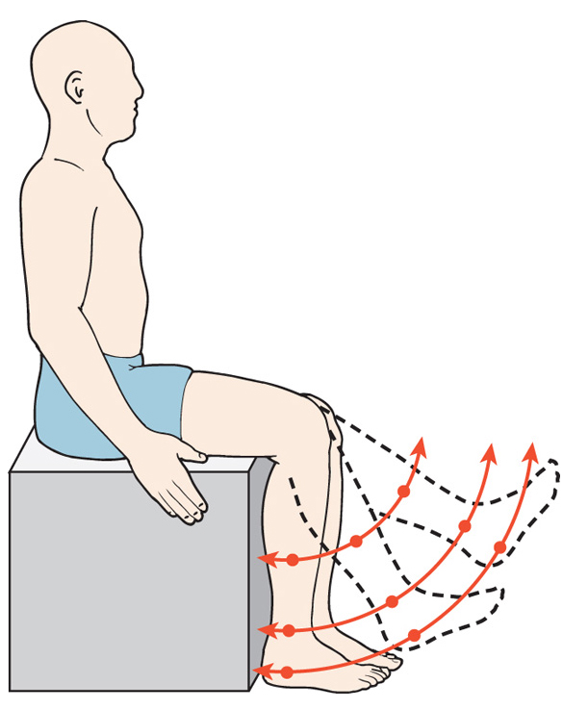
Rectilinear
Motion
Curvilinear
Motion
Angular
Motion

Slide 14
Joint Movement (Osteokinematics)
Osteokinematics- deals with the relationship of the movement of bones around a joint axis
Arthrokinematics- deals with the relationship of a joint surface movement
Joints move in many directions
Synovial joints are freely moveable joints where MOST motion occurs
Active movments- generated by stimulated or “active” muscle
Passive movements- generated by sources other than muscular activation, such as gravity, the resistance of a stretched ligament, or a push from another person

Slide 15
Joint Movements (Osteokinematics)
Flexion- the bending movement of one bone on another, bringing two segments together causing an increase in the joint angle
Extension- straightening movement of one bone away from another, causing an decrease of the joint angle
Hypertension- continuation of extension beyond the anatomical position
Palmar flexion- flexion at the wrist
Plantar flexion- flexion at the ankle
Dorsiflexion- extension at the wrist and ankle

Slide 17
Joint Movements (Osteokinematics)
Abduction- is movement away from the midline of the body
Adduction- is movement toward the midline of the body
Horizontal abduction- starting at flexion or abduction, shoulder movement backward
Horizontal adduction- starting at flexion or abduction, shoulder movement forward
Radial deviation- when the hand moves laterally or towards the thumb side
Ulnar deviation- when the hand moves medially or towards the little finger side
Lateral bending- when the trunk moves sideways

Slide 19
Joint Movements (Osteokinematics)
Circumduction- is motion that describes a circular, cone shaped pattern
Combines flexion, abduction, extension, and adduction

Slide 20
Joint Movements (Osteokinematics)
Rotation- movement of a bone or part around its longitudinal axis
Medial rotation (internal rotation)- when the anterior surface rolls inward toward the midline
Lateral rotation (external rotation)- when the anterior surface rolls outward away from the midline
Spinal rotation- neck and trunk can rotate to either side
Supination- rotation of the forearm to face the palm of the hand forward
Pronation- rotation of the forearm to face the palm of the hand backward

Slide 22
Joint Movements (Osteokinematics)
Inversion- is moving the sole of the foot inward at the ankle
Eversion- is moving the sole of the foot outward at the ankle
Protraction- is mostly a linear movement along a plane parallel to the ground and away from the midline
Retraction- is mostly a linear movement along a plane parallel to the ground and toward the midline

Slide 24
Planes
Saggital plane- passes through body from front to back and divides body into right and left parts
Frontal plane- passes through body from side to side and divides the body into front and back parts
Transverse plane- passes through body horizontally and divides the body into top and bottom parts

Slide 25
Center of Gravity
COG- the point where the three cardinal planes intersect each other
In the human body, that point is in the midline at about the level of, though slightly anterior to, the second sacral vertebrae

Slide 26
Axes(Pivot Point)
Sagittal axis- point that runs through a joint from front to back
Abduction/adduction
Frontal axis- point that runs through a joint from side to side
Flexion/extension
Vertical (longitudinal) axis- point that runs through a joint from top to bottom
Rotation
Notes:
Axis of rotation = pivot point

Slide 27
Degrees of Freedom
Number of planes in which joint can move
Uniaxial joint has one degree of freedom
Biaxial joint has two degrees of freedom
Triaxial joint has three degrees of freedom
Maximum number of degrees of freedom an individual joint can have
Notes:
Ie shoulder has 3 degrees of ROM ---can move freely in all planes of motion

Slide 28
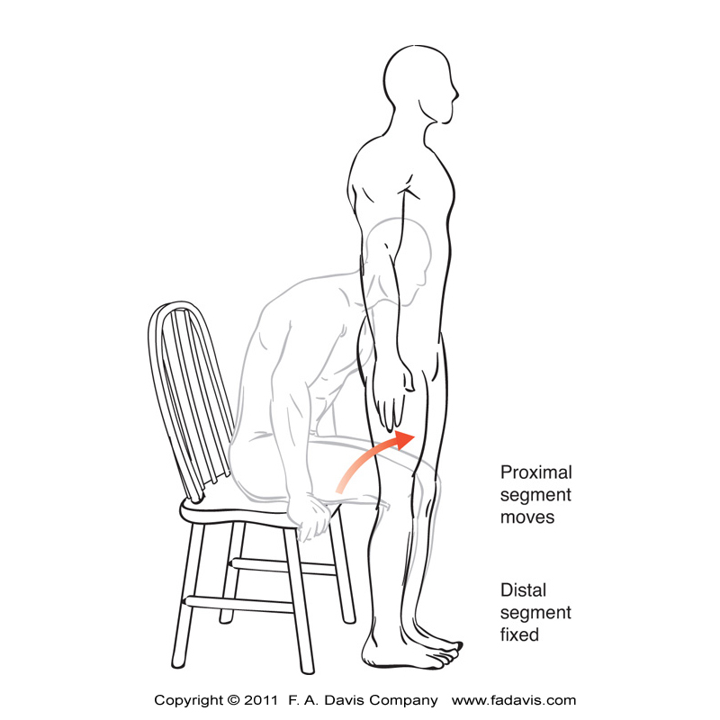
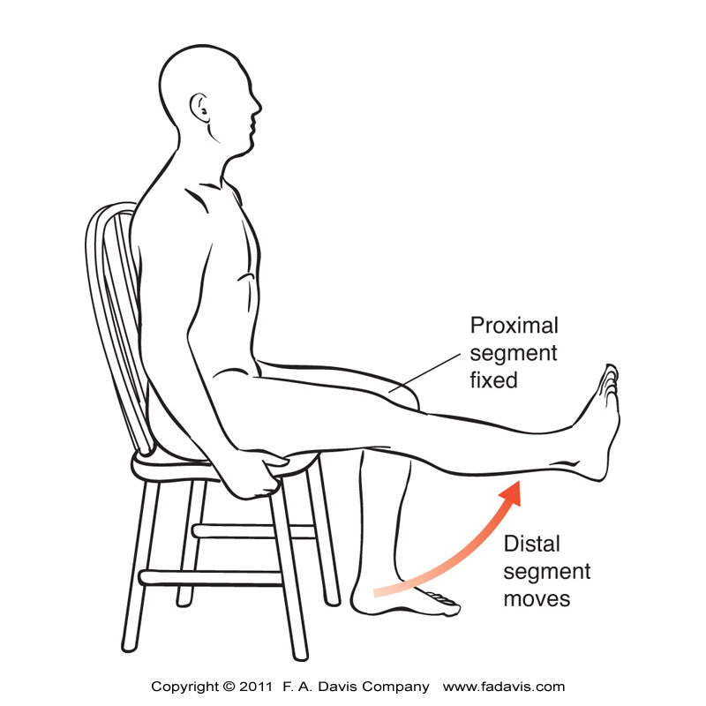
Kinetic Chains
Closed kinetic chain
Distal segment fixed(closed) and the proximal segment moves
Weight-bearing
Open kinetic chain
Distal segment free to move (open) and the proximal segment can remain stationary
Non-weight-bearing
Notes:
CKC exercise thought to be more functional for Le
If ankle DF ROM is limited
CKC knee flexion will be limited

